Slide 1

VARIABLES & OPERATORS

Slide 2
C++ Data Types
All variables use data-type during declaration to restrict the type of data to be stored. Therefore, we can say that data types are used to tell the variables the type of data it can store.
Whenever a variable is defined in C++, the compiler allocates some memory for that variable based on the data-type with which it is declared. Every data type requires different amount of memory.

Slide 3
Data types in C++ is mainly divided into two types:
PRIMITIVE :
These data types are built-in or predefined data types and can be used directly by the user to declare variables. example: int, char , float, bool etc
ABSTRACT
These data types are defined by user itself.

Slide 4
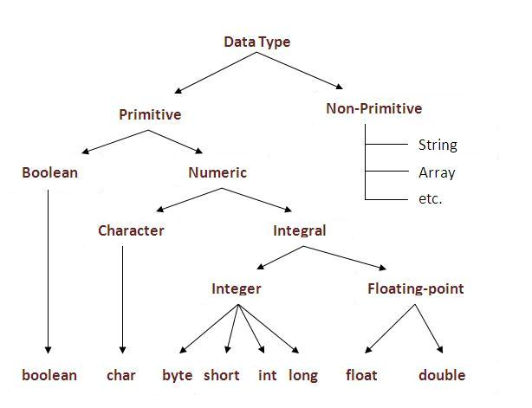

Slide 5
OPERATORS
We can define operators as symbols that helps us to perform specific mathematical and logical computations on operands
For example, consider the below statement:
c = a + b;
Here, ‘+’ is the operator known as addition operator and ‘a’ and ‘b’ are operands

Slide 6
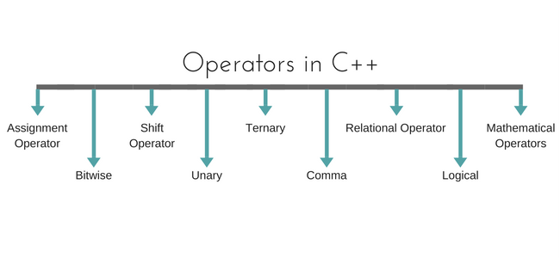

Slide 7
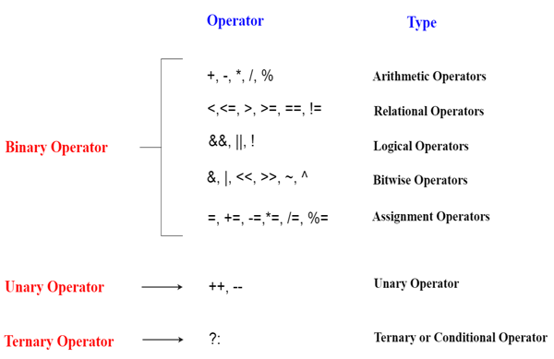

Slide 8
OPERATOR | DESCRIPTION | ASSOCIATIVITY
() | Parentheses (function call) | left-to-right
[] | Brackets (array subscript)
. | Member selection via object name
-> | Member selection via pointer
++/– | Postfix increment/decrement
++/– | Prefix increment/decrement | right-to-left
+/- | Unary plus/minus
!~ | Logical negation/bitwise complement
(type) | Cast (convert value to temporary value of type)
* | Dereference
& | Address (of operand)
Sizeof | Determine size in bytes on this implementation

Slide 9
*,/,% | Multiplication/division/modulus | left-to-right
+/- | Addition/subtraction | left-to-right
<> | Bitwise shift left, Bitwise shift right | left-to-right
< , <= | Relational less than/less than or equal to | left-to-right
> , >= | Relational greater than/greater than or equal to | left-to-right
== , != | Relational is equal to/is not equal to | left-to-right
& | Bitwise AND | left-to-right
^ | Bitwise exclusive OR | left-to-right
| | Bitwise inclusive OR | left-to-right
&& | Logical AND | left-to-right
|| | Logical OR | left-to-right

Slide 10
?: | Ternary conditional | right-to-left
= | Assignment | right-to-left
+= , -= | Addition/subtraction assignment
*= , /= | Multiplication/division assignment
%= , &= | Modulus/bitwise AND assignment
^= , |= | Bitwise exclusive/inclusive OR assignment
<>= | Bitwise shift left/right assignment
, | expression separator | left-to-right

Slide 11
Thank You! Have a nice day…

